Slide 1

Securing the Internet of Things (IoT) and Cloud
Enabling secure IoT integration with Cloud
Feb 2020

Slide 2
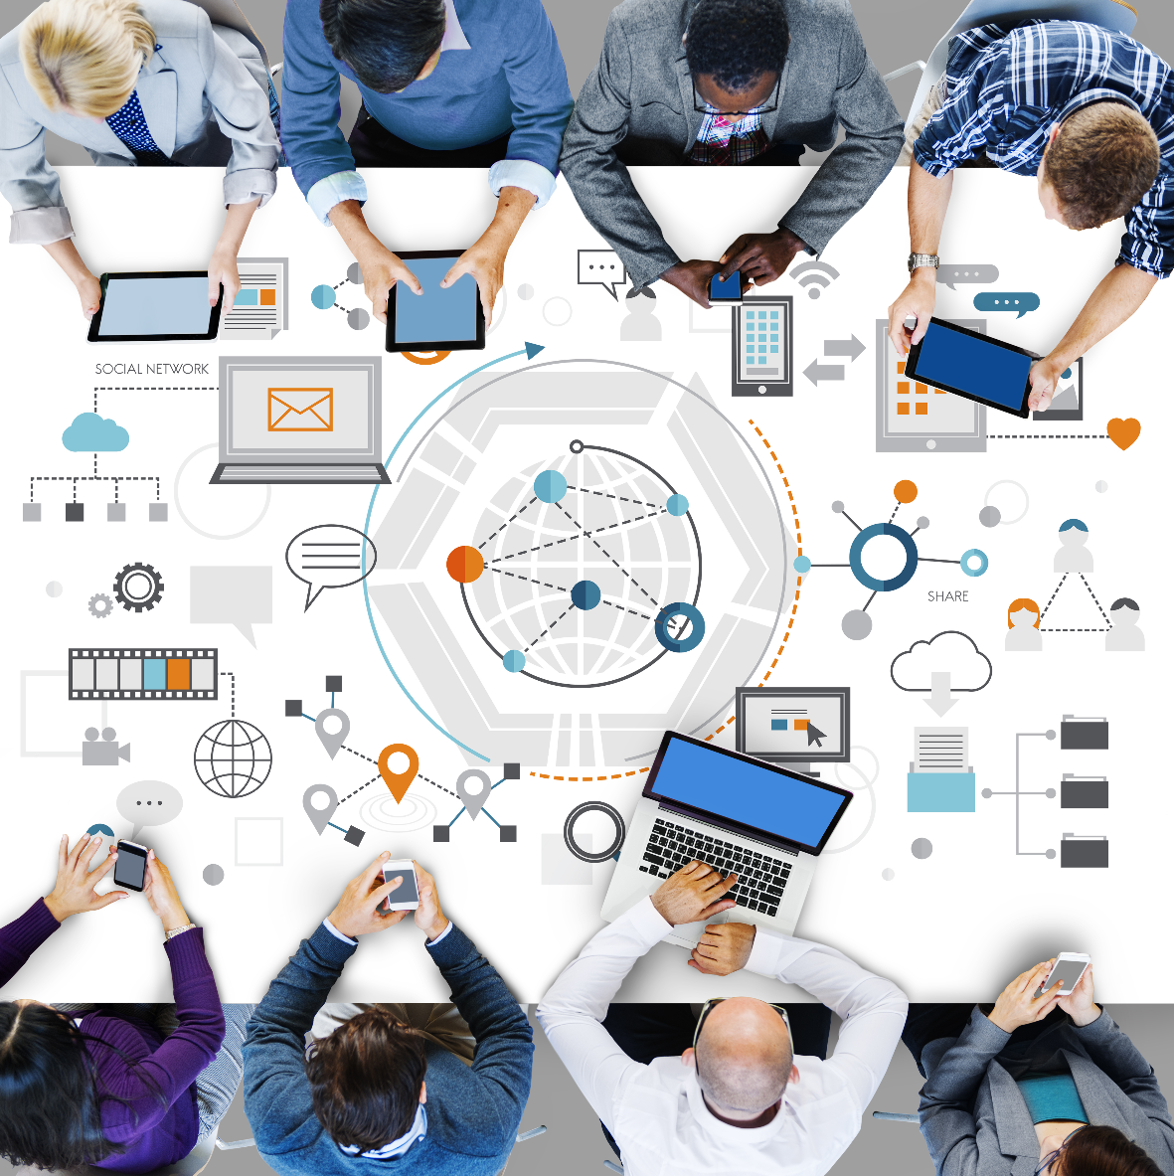
Contents
03
IoT Security Overview
Deloitte’s Capabilities
Cloud & IoT Cyber and Privacy Framework
AWS IoT Security POV
Azure IoT Security POV
07
10
12
19

Slide 3
IoT Security Overview

Slide 4
Growth and prevalence of IoT
IoT devices continue to proliferate and become a common place technology across industries
Exponential growth
Growth implication
Common use cases
Number of Connected Device in Billions¹
$1.2T estimated spend on IoT by 2022²
Smart Cities
Congestion control system
Gunshot detection system
IIoT (Industrial 4.0)
Predictive maintenance
Smart asset tracking and monitoring
Connected Vehicles
Autonomous driving cars
Fleet management
Connected Medical Device
Embedded medical devices
Smart medicines
Smart Homes
Connected appliances
Energy management
$520B estimated growth in IoT and analytics revenue by 2021³
90% of Senior Executives cite IoT as critical to their business³
Sources:
Ericsson Mobility Report, Ericsson, June 2018
Worldwide Semiannual Internet of Things Spending Guide, IDC, June 2018
2018 Roundup Of Internet Of Things Forecasts And Market Estimates, Forbes, Dec 2018

Slide 5
Challenges exist in solving IoT security issues
IoT creates desirable business opportunities, and solves complex problems, however, ensuring secure adoption requires many considerations
IoT data is becoming more and more valuable, but data governance is lacking behind
IoT devices use default passwords and manual password management on devices is costly.
Lack of regulation and uniform standards for IoT security in addition to disparate platforms
Most IoT devices lack sufficient device activity logging capabilities.
IoT device management in a legacy IT architecture requires more complicated security design
Device patching and vulnerability management on a large amount of remote device are difficult.
The security of IoT devices is complex and multi-faceted
Insecure network protocols are typically used to connect IoT devices to the internet.
IoT devices lack identity and authentication-level controls.
Managing large scale IoT devices centrally becomes impossible as the total number of IoT device is growing
Most IoT devices are physically incapable of adequate encryption
Variety of IoT devices within a single network leads to inconsistent communication protocols.
Notes:
Cyber attacks - March 2018 Atlanta Ransomware attack knocked out city services for over a week. Cost over 2.5 million dollars and counting.
Noncompliance - California recently passed privacy legislation (similar to GDPR) with fines associated for each violation. Other states are going to follow.
Deployment if IOT Services - Mirai Botnet used to take control of IoT devices and perform distributed denial of service (DDoS) attacks
Convergence of physical - Atlanta resorted to canceling court dates, city job interviews, sharing computers and using paper records to continue with business
Connected Humans - FDA confirmed last year that St. Jude implantable cardiac devices have vulnerabilities that leave them vulnerable to attack
Legacy Systems - Cities are spending over half of their IT budgets supporting and maintaining legacy, outdated systems that are vulnerable to attack

Slide 6
Cybersecurity is the #1 concern in IoT adoption¹
IoT is part of our every day life yet still not secure
1
Stuxnet (2009)
Stuxnet was a virus aimed at the Industrial Controls Systems (ICS) of a nuclear facility
This hack demonstrated to the world that cyberwarfare was tangible and effective
There were over 5200 IoT attacks to Symantec’s honeypot in 2018². Many of these attacks can be used to affect similar ICS devices as the one targeted in Stuxnet
2
Mirai Botnet (2016) ³
Massive Internet Distributed Denial of Service attack
Caused outages across large parts of the internet
Launched with the help of hacked IoT devices such as CCTV digital video recorders
3
WannaCry (2017) ⁴
Ransomware that infected over 200,000 devices in more than 150 nations
First, large scale cyber-attack that affected healthcare industry directly
Infected tens of thousands of the U.K. National Health Service's hospitals' devices, including MRI scanners
Sources:
The State of IoT Security 2018, Forrester Research, January 2018
Internet Security Threat Report (ISTR), Symantec, 2019
Mirai, Symantec, 2016
What you need to know about the WannaCry Ransomware, Symantec, 2017

Slide 7
Deloitte’s Capabilities

Slide 8

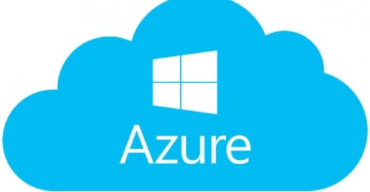
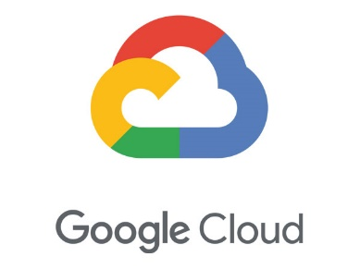
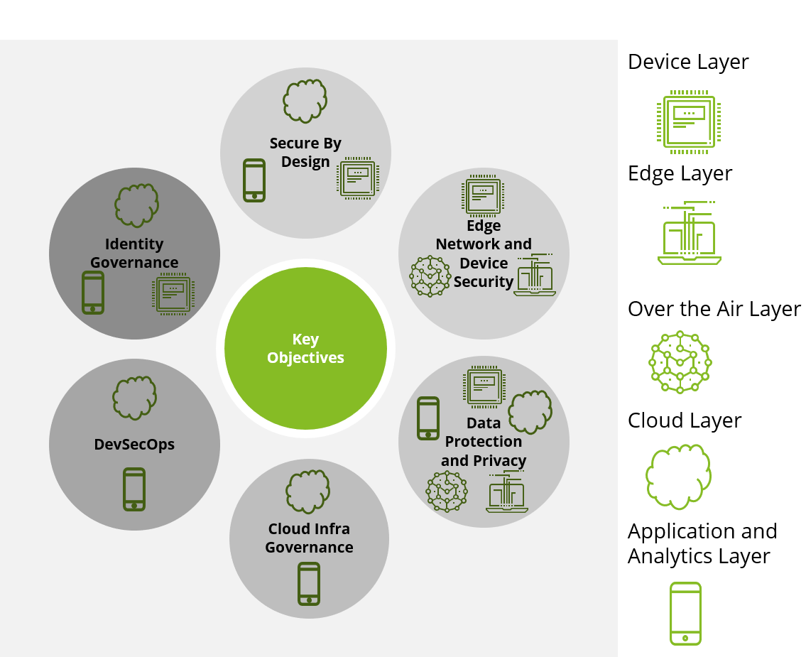
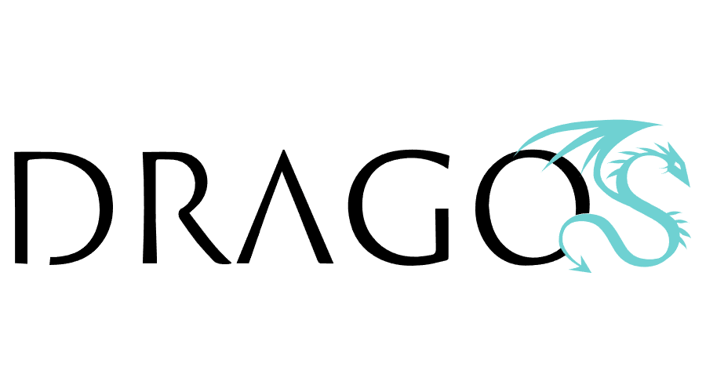

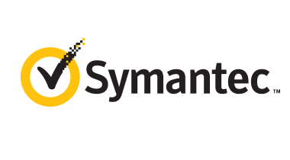


Deloitte’s Cloud & IoT Cybersecurity and Privacy Offering
The Deloitte Differentiator
Deloitte employs over 1,400 Certified Systems Security Specialists (CISSP) and over 500 cloud security professionals across the three largest Cloud providers: AWS, Azure, and GCP. with vast industry experience in life sciences and health care, automotive, and industrial control system, as well as extensive experience with digital transformation, our professionals enable our firm to provide end-to-end infrastructure cyber risk solutions in the IoT space.
Offer a wide breadth of security capabilities with the aim to prevent cyber attacks by implementing preventative security controls around IoT devices
Engage security capabilities that detect potential threats and alert when those threats may occur
Embed security capabilities that increase infrastructure resiliency in the event of an attack
Identify and protect
Detect
Respond and recover
Cloud & IoT Security Framework
Business Objectives
Growth & Innovation
Operational Efficiency
Brand Protection
Risk-Based Decision Making
Compliance
Organization and Leadership
IoT Steering Committee
Cloud Center of Excellence
Information
Security
Application /
DevOps
Information Technology
Legal &
Compliance
Product
Procurement
Operating Model Components
Governance &
Oversight
Policies &
Standards
Management
Processes
Tools &
Technology
Risk Metrics &
Dashboard
Fundamental Components
Know your Device
Know your Cloud
Know your Data
Know your Customers
Know your Third-party
IoT Value Chain Perimeter
Device Layer
Edge Layer
Over the Air Layer
Cloud Layer
Application Layer
Identify
Protect
Detect
Respond
Recover
Identity Management and Access Governance
Data Classification and Analysis
Certificate Management
Device & Asset Management
Infrastructure & Network Security
Device Hardening
Privacy Protection
OS & App Security
Device Lifecycle
Threat Intelligence
Compliance Monitoring
Anomaly Monitoring
Vulnerability Management
Centralized Logging
Risk Analytics
Security Incident & Event Management
Automated Remediation
Incident Response
Digital Twin and Intermittent Connectivity
OTA and Remote Control
Disaster Recovery and Foggy Continuity
Post Incident Forensic Analysis
Architecture & Process Decoupling
High Availability & Redundancy
Cyber Risk Domains
Deloitte Accelerators and Tools
Deloitte IoT Vendor Solutions

Slide 9











Deloitte’s High-Level Approach
Assess
Design
Implement
Operate
IoT and edge computing infrastructure review and assessment
Device pen-testing and vulnerability exploration
IoT ideation lab
Current architecture review and security posture summarization
Automated Core assessment
In-depth Core assessment
Integrated risk framework consolidation, and cyber risk strategy design
Privacy assessment and gap identification against CCPA, GDPR
Emerging risk profiling and remediation strategy design
Gap analysis and target sate design workshops
Architecture, process, and technology integration design
Roadmap development for enhancing Edge security capabilities
Cloud and IoT security and privacy roadmap development
Cloud and IoT infrastructure strategy & business case development
Identity Management and Access Governance, Enterprise Guardrails, and data protection security stack customization
Reference security architecture pattern customization
Edge security hardening automation
Vertical security integrated program build
IoT Core infrastructure security capabilities build
Security use case build and testing
Core security stack instantiation
Security full-stack implementation
SIEM implementation
Disaster recovery, breach detection and response capabilities
DevSecOps and CI/CD integration
Deloitte Dragos Managed Services
Scalability support and solution replication
Device lifecycle management
IoT Security Managed Services
Solution maintenance and go-live support
Training -Security Operation KPI design and implementation
Managed SOC services
Deloitte Open Cloud Managed Services
Transforming
Connected
Vehicles
Medical
Devices
Smart Cities
Industrial IoT
Industries
Successful Use Cases
Global Fortune 500 Travel & Hospitality
Objective: Optimization of existing Cloud processes
Impact: Cloud security assessment and roadmap
Global Fortune 500 Travel & Hospitality
Objective: IoT implementation strategy
Impact: IoT security implementation and operations
Global Fortune 100 C&IP Company
Objective: Medical IoT Device
Impact: Cloud security roadmap and implementation
Contact Our Leaders
Sean Peasley
Partner, Cyber Risk Services
Deloitte & Touche LLP
IoT Security Leader
speasley@deloitte.com
Kieran Norton
Principal, Cyber Risk Services
Deloitte & Touche LLP
Cloud Infrastructure Leader
kinorton@deloitte.com
Ravi Dhaval
Senior Manager, Cyber Risk Services
Deloitte & Touche LLP
Cloud & IoT Security and Privacy Leader
rdhaval@deloitte.com

Slide 10
Deloitte’s Cloud IoT Cyber Framework

Slide 11
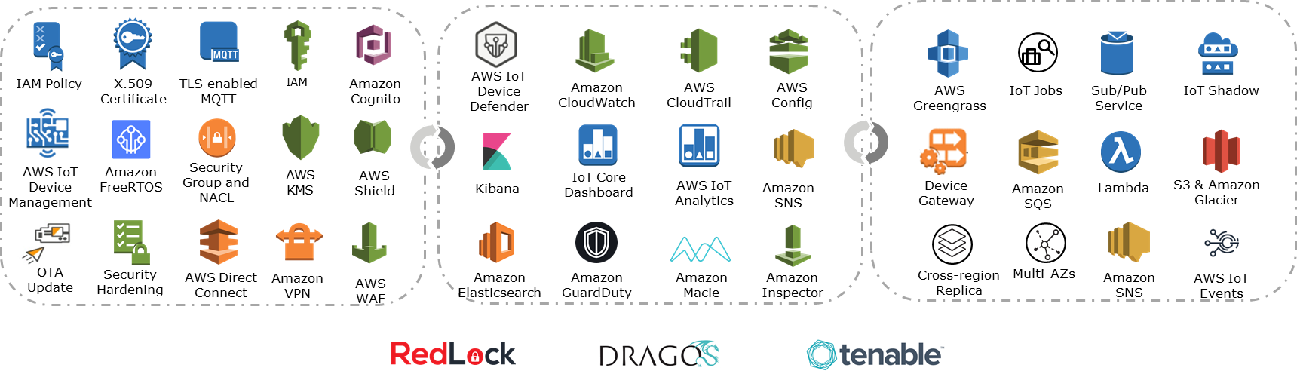
Deloitte’s Cloud IoT Cyber Framework
Business-driven risk framework aligned with strategic objectives to address IoT cyber challenges
Business Objectives
Growth &
Innovation
Operational
Efficiency
Brand
Protection
Risk-based
Decision Making
Compliance
Organization and Leadership
IoT Steering Committee
Cloud Center of Excellence
Information
Security
Application /
DevOps
Information Technology
Legal &
Compliance
Product
Procurement
Operating Model Components
Governance &
Oversight
Policies &
Standards
Management
Processes
Tools &
Technology
Risk Metrics &
Dashboard
.
.
.
.
.
Fundamental Components
Know your Device
Know your Cloud
Know your Data
Know your Customers
Know your Third-party
IoT Value Chain Perimeter
Device Layer
Edge Layer
Over the Air Layer
Cloud Layer
Application Layer
Prevention
Detection
Remediation
Device Hardening
Infrastructure & Network Security
Identity Management
and Access Governance
Data & Privacy Protection
Device Lifecycle
Certificate Management
Device & Asset Management
OS & App Security
Threat Intelligence
Compliance Monitoring
Anomaly Monitoring
Vulnerability Management
Centralized Logging
Risk Analytics
Security Incident & Event Management
Automated Remediation
Incident Response & Forensics
Digital Twin and Intermittent Connectivity
OTA and Remote Control
Architecture & Process Decoupling
Disaster Recovery and Foggy Continuity
High Availability & Redundancy
Cyber Risk Domains
Technologies and Tools
Notes:
Industry Standards
ISO¹ 27001/2
NIST² cybersecurity framework
Global privacy and data protection laws
ITIL³
^{Leading Practices}
Recognized information security leader
Project / engagement experience
Published industry research
Threat Landscape
Who might attack?
What are they after?
What tactics will they use?
¹ International Organization for Standardization
² National Institute for Standards and Technology
³ Formerly known as the Information Technology Infrastructure Library

Slide 12
AWS IoT POV

Slide 13


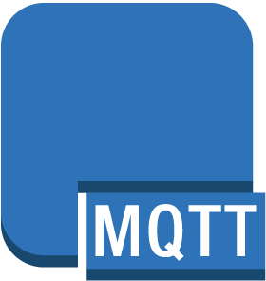








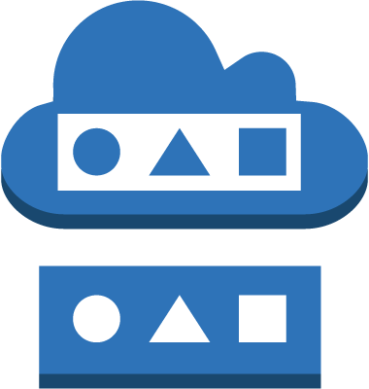










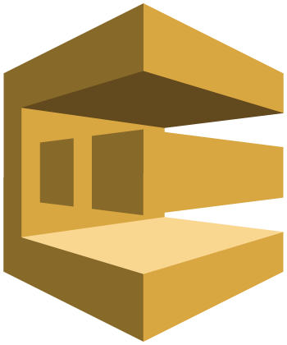







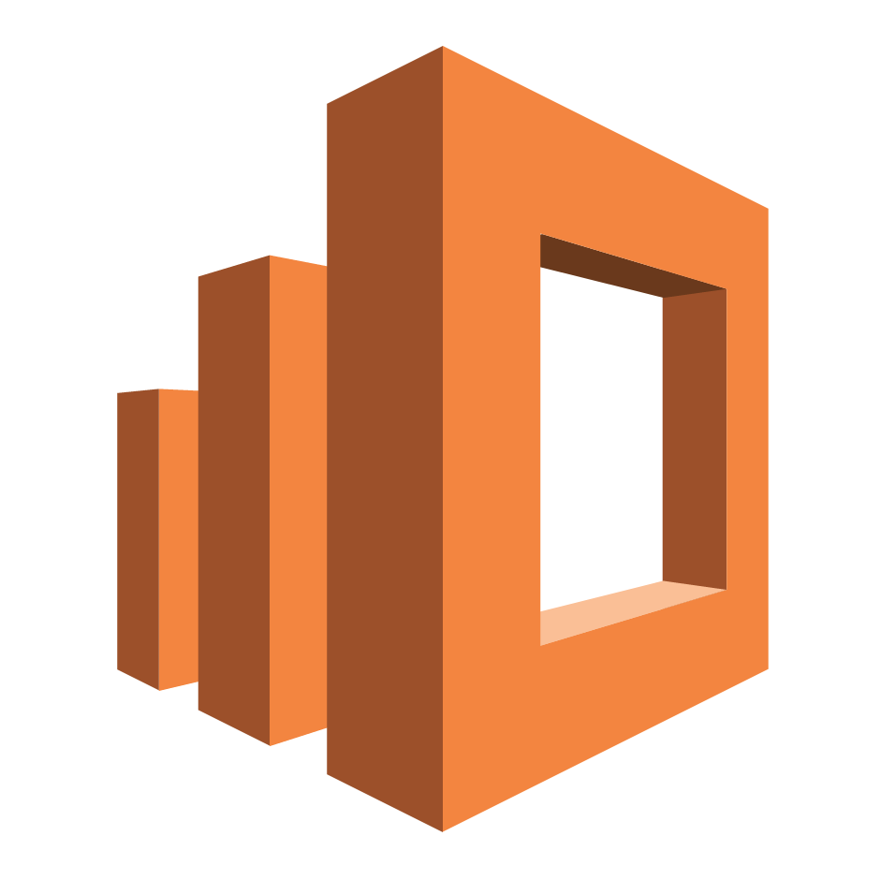



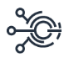
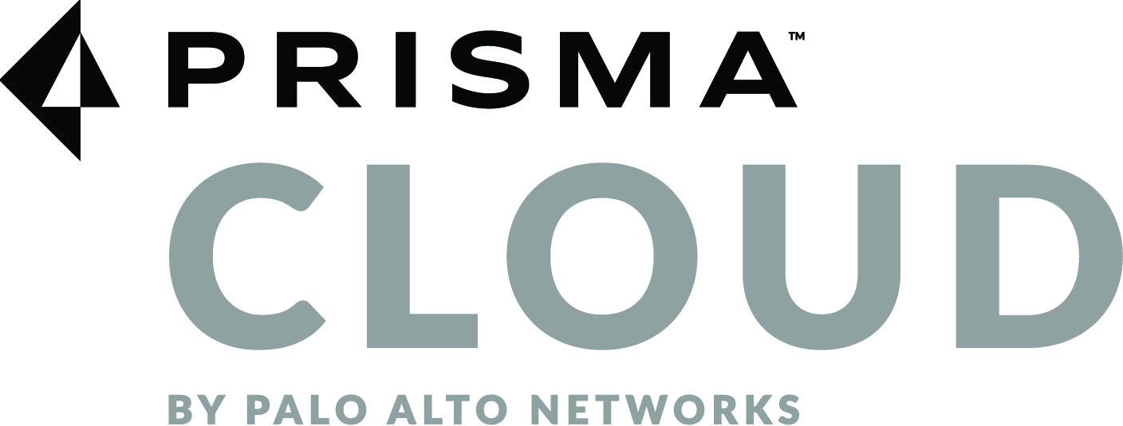


Deloitte’s Cloud IoT Cyber Framework supported AWS solution stack
Leveraging Deloitte Cloud IoT Cyber Framework to create a secure IoT platform for your organization
IoT Value Chain Perimeter
Device Layer
Edge Layer
Over the Air Layer
Cloud Layer
Application Layer
Prevention
Detection
Remediation
Device Hardening
Infrastructure & Network Security
Identity and Context
Data& Privacy Protection
Access Management
Device Lifecycle
Certificate Management
Device & Asset Management
OS & App Security
Threat Intelligence
Compliance Monitoring
Anomaly Monitoring
Vulnerability Management
Centralized Logging
Risk Analytics
Security Information & Event Management
Automated Remediation
Incident Response & Forensics
Digital Twin and Intermittent Connectivity
OTA and Remote Control
Architecture & Process Decoupling
Disaster Recovery and Foggy Continuity
High Availability & Redundancy
Cyber Risk Domains
IAM Policy
X.509 Certificate
TLS enabled MQTT
IAM
Amazon
Cognito
AWS IoT Device Defender
Amazon CloudWatch
AWS
CloudTrail
AWS
Config
AWS
Greengrass
IoT Jobs
Sub/Pub Service
IoT Shadow
Technologies and Tools
AWS IoT Device Management
Amazon FreeRTOS
Security Group and NACL
AWS
KMS
AWS
Shield
IoT Core Dashboard
Kibana
AWS IoT Analytics
Amazon SNS
Device Gateway
Amazon
SQS
Lambda
S3 & Amazon Glacier
OTA Update
Security Hardening
AWS Direct
Connect
Amazon
VPN
AWS
WAF
Amazon Elasticsearch
Amazon GuardDuty
Amazon Macie
Amazon Inspector
Cross-region Replica
Multi-AZs
Amazon
SNS
AWS IoT Events

Slide 14
AWS IoT core backbone architecture
Reference architecture that emulates a real IoT solution in the field
Data flow and traffic

Slide 15
AWS IoT data value chain
Data generated from Edge is transmitted, processed, transformed, stored, and analyzed in cloud. Providing end to end security right from device to the cloud
4. Stream high-velocity data via Kinesis to ELK for real-time monitoring
4
1. Store device data to NoSQL DynamoDB for data parsing
7. Store data directly to S3 for log centralization
1
2
2. Store data in different data sets via data pipelines for analysis
7
5. Stream high-velocity data to S3 via Kinesis
5
6
3
6. Visualize data in ELK stack
3. Analyze data in Quicksight to aid reporting and decision making

Slide 16
Identify & Protect
Deloitte’s solution offers a wide breadth of security capabilities that aim to prevent attacks by implementing preventative security controls
1 | Multi-factor Auth
2 | WAN Security
3 | Non-Default Credentials
4 | Identity Management and Access Governance
5 | Network security & Traffic monitoring
6 | Intrusion Prevention & Whitelisting
7 | Device Identity and Encrypted Transmission
8 | Data Protection and Certificate Management
1
3
6
2
2
3
1
4
7
5
5
8
6
7
8
4

